Slide 1

SREENIDHI INSTITUTE OF SCIENCE AND TECHNOLOGY (An Autonomous Institution Approved by UGC) Yamnampet, Ghatkesar, R.R. District -501 301 Department of Data Science
Group Project – I
On
“Personalised News Feed Generator”
by
Amrutha Varshini (21311A6727)
Vivek sai Sheelam (21311A6718)
Dr. Divya Naadem, Dr. K. Premnadh
Associate Professors Dr. Jaffer Sadiq
Professor
Head Of Department

Slide 2
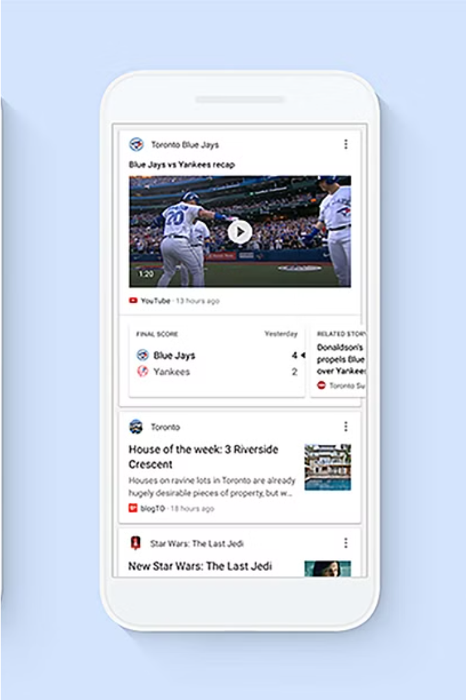
Personalized News Feed Generator
This presentation explores a personalized news feed generator that leverages content-based filtering with TF-IDF to deliver highly relevant and engaging news content to users. By understanding individual preferences and interests, this system aims to enhance user experience and retention.

Slide 3
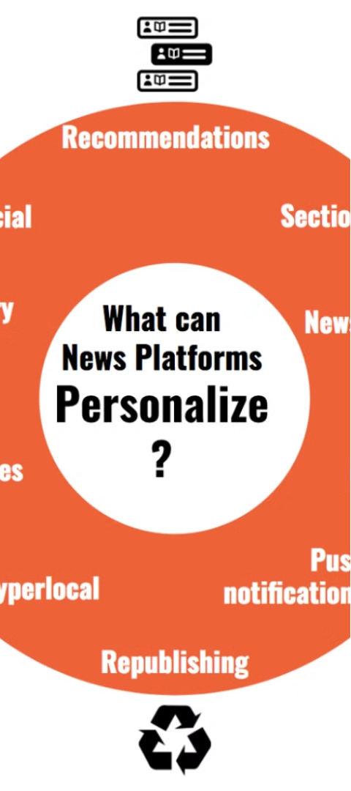
Importance of Tailored News Feeds
1
Relevance
2
Retention
Personalized news feeds ensure users receive content that aligns with their interests, improving engagement and satisfaction.
Tailored news feeds keep users coming back by continuously providing valuable and engaging information.
3
Discovery
The system can surface unique, niche content that users may not have discovered on their own.

Slide 4
Existing System: Hybrid Approach
Collaborative Filtering
And other various algorithms
Hybrid Approach
Recommends items based on user preferences and the behavior of similar users.
Recommends items based on
various factors.
Combines collaborative and other methods to provide more comprehensive recommendations.

Slide 5
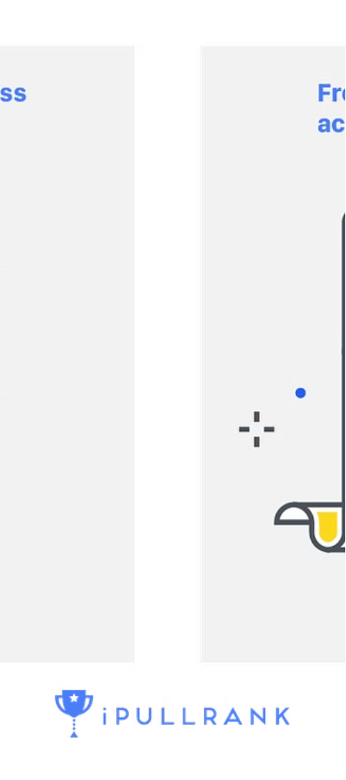
Proposed : Recommendation based on content
1
Web scraping
We use web scraping methods to extract the headlines of various news. After collecting we preprocess the data.
2
TF-IDF Calculation
Term Frequency-Inverse Document Frequency (TF-IDF) is used to determine the importance of each word in the articles. Then we will find the cosine similarity to find the similar news headlines.
3
User Profiles
User preferences are modeled based on the TF-IDF scores of articles they have engaged with.

Slide 6
Process Workflow
1
Data Collection
2
User Interaction
3
User Profile Building
Collect headlines from various news channel pages using web scraping.
Understand user engagement and preferences.
Build detailed user profiles based on interests and history.
4
Recommendation
Match user profiles to news articles and generate personalized recommendations.

Slide 7
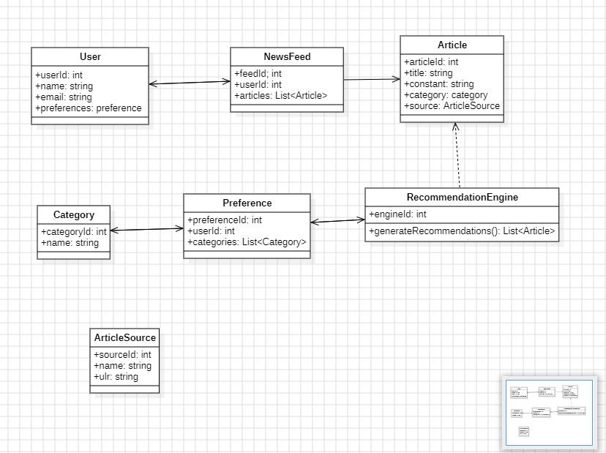
Class Diagram:

Slide 8
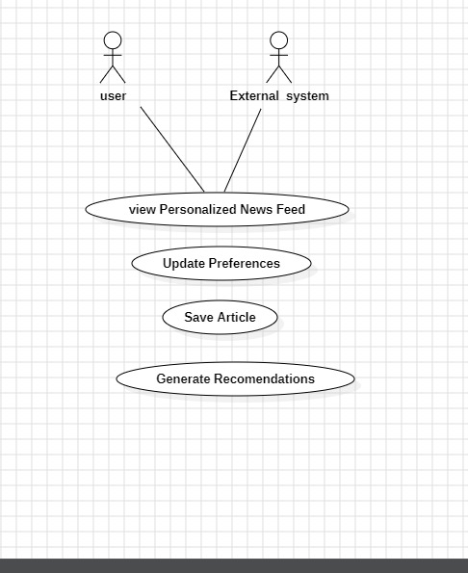
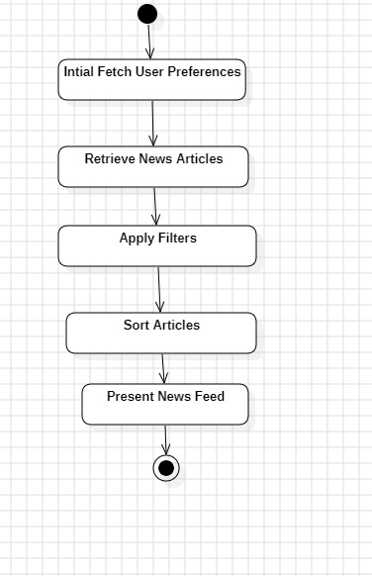
Activity Diagram:
State Chart Diagram:

Slide 9


Any Questions?
Questions?
Thank You
Please feel free to ask any questions about the personalized news feed generator.
We appreciate your time and interest in this presentation.

